Slide 1

HP Enterprise Group SLED Strategy & Programs

Slide 2
FY15 U.S. EG SLED Sales Team Mission
Create an ecosystem of partners, programs and contracts that drive HP revenue growth through true Partner-led Indirect sales.
Programs
Solution & Training Focus
Easy & Efficient to Execute
No/Low/Min Touch Strategy
Competitively Priced
Partner Margin Rich
Key Principles
Make SLED an attractive market
Make HP easy to do business with
Allow partners to earn higher GM% on HP vs. competition
Contracts
Enable for indirect
Selected partner inclusion
Renegotiate for EG vs BU
Procurement reform for New Style of IT
Partners
Enable to be HP’s sales force
Link contract to growth
Segment value vs volume
Monitor business plan perf
Link to mktg/demand gen
Notes:
IN FY14, the U.S. EG SLED team continues the transformation to a partner-led. Having established in FY13 the basics of accommodating partners’ ability to transact business with HP, the focus will be on elevating the game on all fronts – for programs, partners, and contracts.
Program focus will be anchored on key SLED industry issues. Pricing has been consolidated into a Volume framework and SLED-specific VEP structure that makes 75% of deals no or low touch for partners. Programs will now focus on solutions and training, enabling partners to see and pursue SLED-specific market opportunities with context-relevant tools to develop and sell HP solutions.
Partners will be segmented to allow some to focus on low-touch, high volume transactional business, while a core group is cultivated to focus on larger value solutions. With measurement now in place, partners will be evaluated for programs and contracts based on their business performance.
Contract focus will remain on migration to indirect, with better partner selection criteria now in place to guide partner selection. The focus will also be expanded to include and effort to reform those contracts to better accommodate the products needs in the New Style of IT (cloud, converged systems, etc)

Slide 3
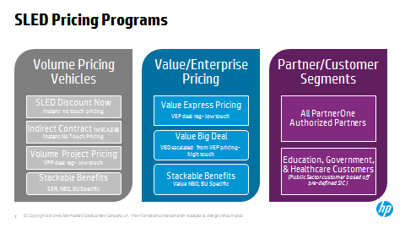
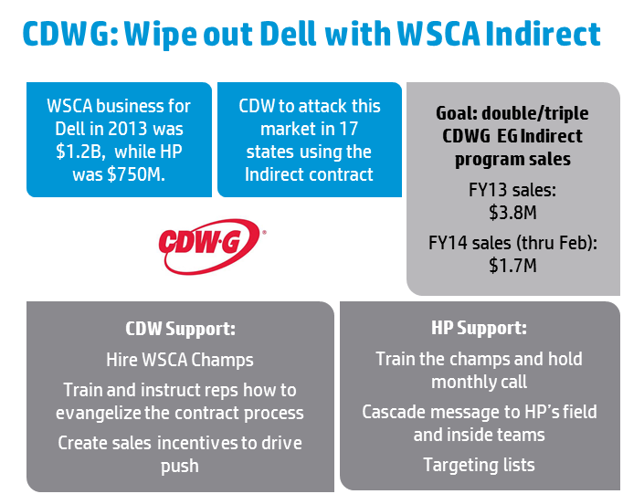
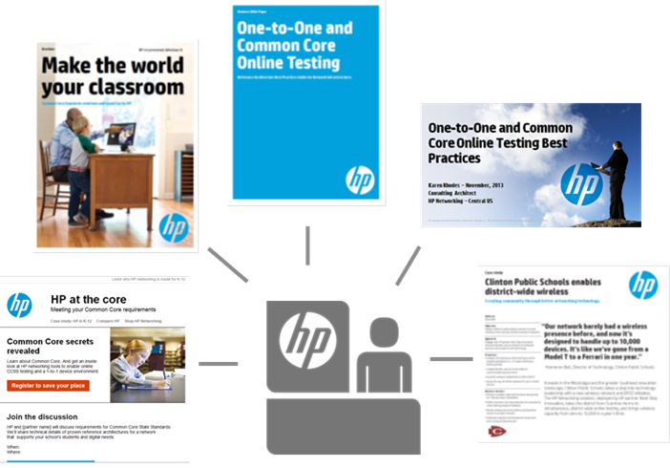

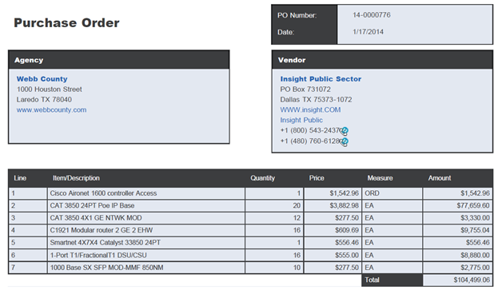
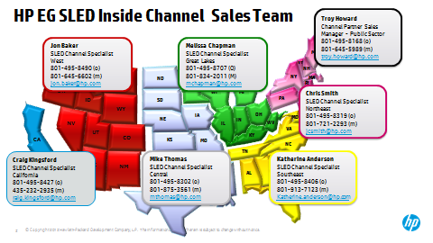
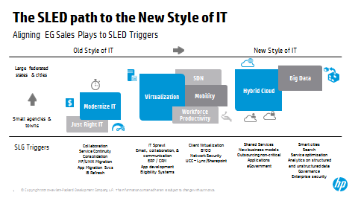
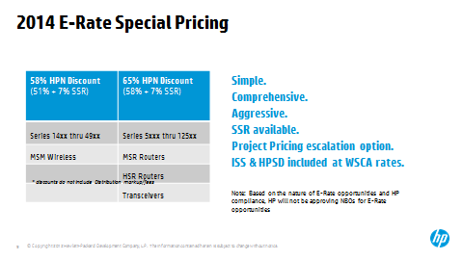
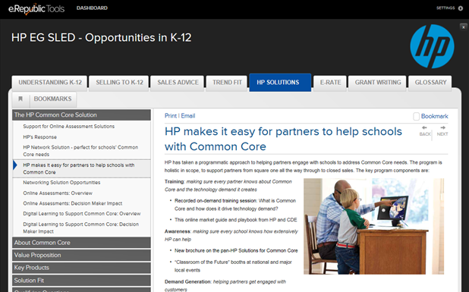
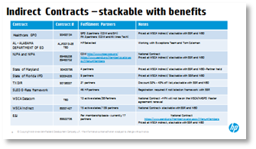
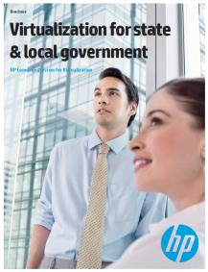
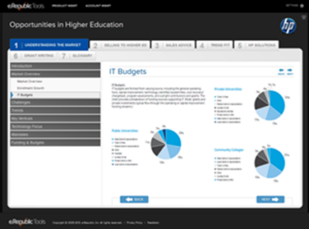
EG SLED Partner Enablement
Transformation of Operational Processes, Strategic Alignment, and Field Engagement
HP Interface: Reduce Friction
SLED pricing model
Contracts
Marketstar team
Monthly webcasts & newsletter
Customer Interface: Increase Traction
Market Guide
Lead Generation
Marketing/Collateral
Events
Programs: Solutions Focus
K-12:
School Day (Mobility)
E-Rate
Common Core
HED:
Mobility
Virtualization
SDN
SLG:
Modernize IT
Mobility
Virtualization

Slide 4
The Wireless Network Landscape is Evolving

Slide 5


Legacy networks unable to meet today’s demands
Network is not aligned to the requirements of the organization
Costly manual configuration and management
Limited IT resources
Poor application experience, unable to meet upcoming requirements
Notes:
Our customers are right, these are real issues that exist because of legacy networks.
Legacy networks are not able to meet today’s demands because they are not aligned to business requirements.
With the consumerization of IT, users expectations are higher than ever. The experience they have with corporate networks is leaving them unsatified due to poor application performance.
IT organizations are also facing limited budgets and resources while being expected to do more with less. This becomes challenges as complexity continues to increase.
Finally, as the network remains primarily a cost center, it lacks compelling business value. We are looking to change that.

Slide 6



Separate Wired & Wireless Architectures & Networks
Legacy wireless deployment model
Wired Network
Wireless Network
Desktops
Mobile devices
Access points
Access switch
WLAN controller
Core switch
Core switch
Wired Network Management Application(s)
Wireless Network
Management Application(s)
Notes:
Here’s an example of a typical legacy WLAN. With separate management and architecture, companies are spending more time and money than necessary, while often delivery a poor user experience.
Two separate networks, separate management

Slide 7

Unified Wired-Wireless Network
Unified Wired-Wireless Network
Desktop & Mobile devices
Access points
Unified Wired-WLAN Switch Infrastructure
Integrated Security – Access Control and IPS
Single-pane-of glass management
Notes:
HP Networking delivers a unified wired and wireless network that simplifies management and access so you can lower costs and cut complexity. You’ll be able to better meet the high-performance demands of today’s mobile centric world.

Slide 8
How we “Make It Matter” in Education

Slide 9

Key Trends: The future of education
1
Personalized Learning
2
Mobility & BYOD
3
Education as a National Strategy
4
Privacy & Security
5
Curriculum Standardization

Slide 10

IT challenges in school environments
$
IT
Not enough time IT Generalists dealing with ever increasing workload and infrastructure complexity
Not enough money Budgets not keeping pace with demanding applications and end-user requirements
Too much risk Equipment failure, human error, and increasing security threats can cripple network access
Notes:
Not enough Time - New workloads and increasingly complex IT environments have not been met with an increase in headcount within most SMB IT organizations.
Administrators need to focus on advancing the business, and not wasting time performing tasks that do not directly provide business value.
Not enough Budget - IT managers have challenges managing tight budgets while being asked to provide more business value for each dollar spent on infrastructure.
While budgets may have grown through time, they have not expanded at the same rate as project requests.
Too much Risk— Risks from natural disasters, equipment failures, data corruption, malicious electronic attacks, and physical security issues are the types of things that keep IT managers awake at night.

Slide 11





Vision:
For those who recognize technology's capacity for transforming education, HP’s hardware, software and services provide total access to resources and enable true learning to create meaningful outcomes.
Total
Access
True
Learning
Meaningful
Outcomes

Slide 12
Introducing HP Cloud-Managed Networking

Slide 13
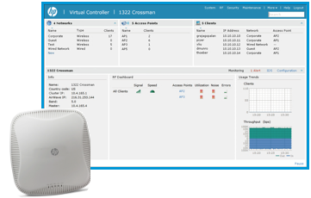

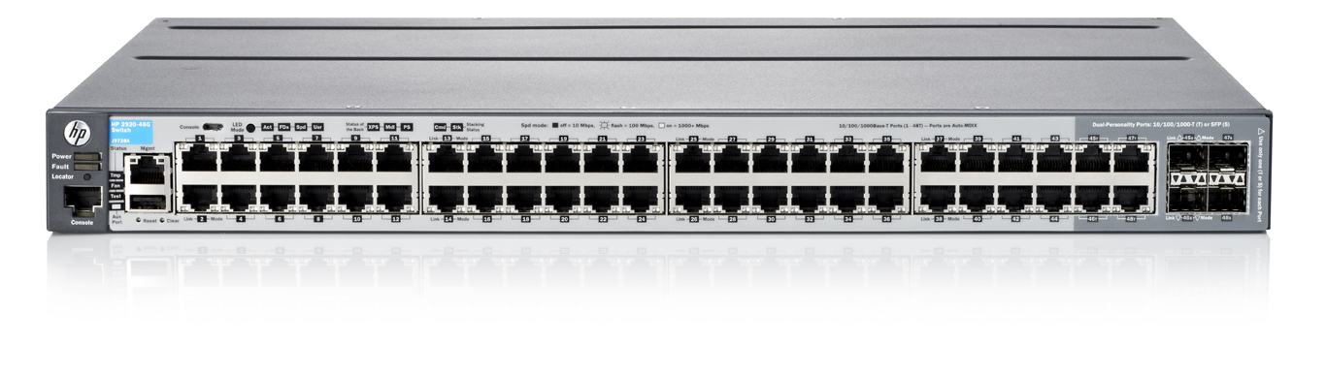
Simple & easy to manage network solution
HP Cloud-Managed Networking
Cloud Network Manager
Lowers upfront costs with pay as you use cloud service model
Simplifies day to day operations by eliminating the need for on site IT
Get users online faster with single-click network deployment
Lowers TCO with Lifetime Warranty 2.0 on access points
HP 365
HP 355
HP 350
3X3:3 802.11ac/n
3X3:3 802.11n
2X2:2 802.11n
Up to 33% lower upfront cost¹
Requires Zero on-site IT²
^{1,2} Based on HP internal calculations
Notes:
Bullets:
For remote and small offices – where they have limited IT resources or staff – and for IT organization moving to the cloud
Our cloud managed solutions – provides a simple and easy-to-manage network so they don’t have to deploy a controller on-site and management is provided through the cloud
The solution lowers upfront cost by 33% with a pay-as-you use model
Eliminates the need for on-site IT
And gets users online faster with one-click deployment

Slide 14
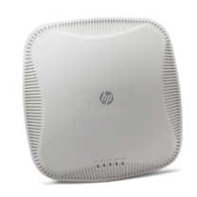
HP Cloud Managed Access Points
Automatically provisioned from the Cloud
Enhances Wi-Fi & client performance with Clear Connect
Interference mitigation
Airtime fairness & band steering
Motion aware roaming
Increases redundancy with dual ISP uplink
Continues to operate in case of WAN link failure
Supports Lifetime Warranty 2.0
HP 365 Cloud Managed AP | HP 355 Cloud Managed AP | HP 350 Cloud Managed AP
Highest performance high client densities | High performance voice and multimedia | Cost effective & reliable wireless
802.11ac. 3X3 MIMO 1.3 Gbps | Dual band 802.11n. 3X3 MIMO 450 Mbps | Dual band 802.11n. 2X2 MIMO 300 Mbps

Slide 15


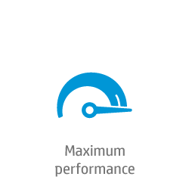
Offering the Optimal WLAN System
Unified wired & wireless solutions
Cloud Managed
On Premise
HP Cloud Network Manager
HP Intelligent Management Center
Access Layer
Core Layer
Limited IT staff?
Moving to cloud?
Need more scalability?
Need granular control?
Tablet
laptop
SDN Applications
Tablet
laptop
Controlled
802.11ac
Access point
Cloud Managed 802.11ac Access Point
HP SDN Controller
PoE+
IP phone
IP phone
PoE+
Access Switch
Access Switch
HP 850/870 Unified Wired-WLAN Controller Appliance
Desktops
Desktops
Smaller Schools and Branch Offices
District, Campus and Universities Enterprise
Notes:
Bullets:
To put this into perspective, how all of these innovations come together to deliver outcomes to various customer segments–
For distributed offices (small scale) or SMB customer segment: where you have limited IT resources or staff – and for IT organization moving to the cloud already, our Cloud Managed solution is ideal…
You don’t have to deploy a controller hardware on-premise – only access points which can all be provisioned with few clicks
And you can reduce your upfront cost based on the cloud subscription based model
For the medium and large enterprise customer segment, we recommend our on premise solution. In these demanding environments you need more control and much higher scalability – This solution delivers:
unified wired & wireless solution that is SDN-enabled, investment protection for future – by extending SDN to WLAN or if needed ability to deploy SDN with Campus SDN applications
Scale up to 30,000 clients
You can optimize the performance of your wireless network
While also setting consistent policies for both wired & wireless network – with a single pane-of-glass management tool.

Slide 16
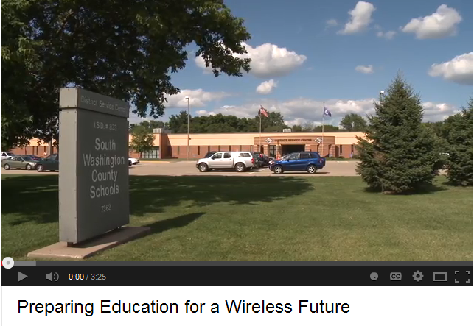
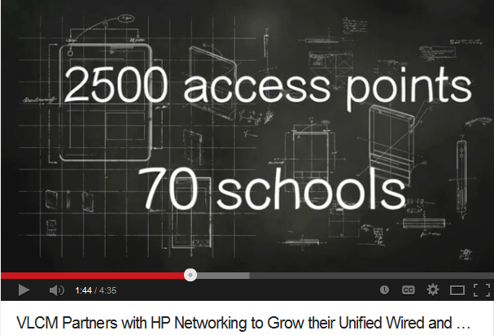
Case Studies
Building customer confidence by sharing stories of HP networking solutions.
play
download
download
play
Notes:
Alpine School District Video (2500 access points and 70 schools)
Company background:
Alpine School District is the largest school district in Utah with 74,000 students.
Challenge: 1) Needed to replace aged infrastructure (100% forklift); 2) keeping up with high student growth rates; 3) address each individual school’s technology goals, including 1 AP per classroom.
Competition: All major WLAN vendors - Ruckus, Aruba, Cisco (Meraki), etc
Solution: During phase 1, customer deployed 2,637 MSM460’s throughout 80 locations. This solution is running alongside their HP Core (10500) and comware deployed throughout the district. They are using IMC and the WSM module to help manage the environment. Through Phase 2, the plan is to increase density and introduce 802.11ac.
Benefits: Since December 2013 the school district has peaked with 46,000 users on the WLAN and their average being about 26,000 users. Customer is on schedule to meet their long term goals. Currently they have more users connected on their wireless network than the wired network. Because the solution is so easy to manage they can easily adapt to constantly changing demands that each school is requesting from the wireless network.
Differentiator: Customer satisfaction with solution and partner services; Valcom has kept one of their engineers onsite part time since the initial launch which has been a huge asset to the customer; delivering up to TBD % TCO improvement vs. competition. The manageability offered by IMC and Lifetime Warranty were also major differentiators. They also saw the 3X3X3 technology included in the 460 AP as a key differentiator.

Slide 17
Thank you
Notes:
Thank you

Slide 18
One-to-One and Common Core Online Testing

Slide 19
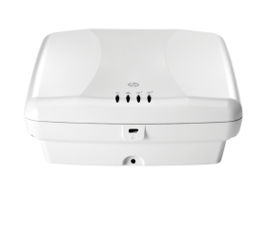

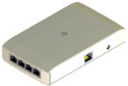
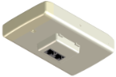
Delivering wired experience for wireless users
802.11ac access points provide next-generation technology
HP 560 Access Points
Improves user experience with IEEE 802.11ac speeds
Simplifies deployment with unified wired & wireless wall jack form-factor
Provides investment protection with OpenFlow support and Lifetime Warranty 2.0
Dual 3x3:3 combo 802.11ac AP powered by PoE
HP 517 Unified Wall Jack
4 GbE ports for VoIP phones & IPTV equipment
3x faster than 802.11n¹
28% more clients ²
¹ 450Mbps vs 1.3Gbps theoretical
² HP 560 vs Aruba 225 & Cisco Aironet 3600
Notes:
Bullets:
Growing number of mobile devices on network will increase by 50B in 2020 (Ericsson) – due to trends like eLearning, video streaming and UCC – all require higher scalability and performance – as users expect wired like experience with wireless
The new HP 560 & 517 IEEE 802.11ac wireless access points enables organizations to support the growing number of mobile devices and delivers better user experience
Delivers mission application performance 3X faster than 802.11n
Can scale to support 28% more users than competing solutions from Cisco and Aruba
HP is future-proofing the network and will support OpenFlow on the HP 560 to enable SDN to the wireless edge so customers can take advantage of applications which delivers agility

Slide 20
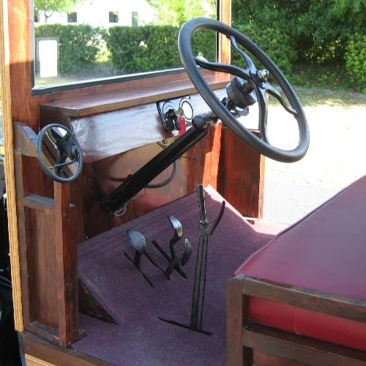
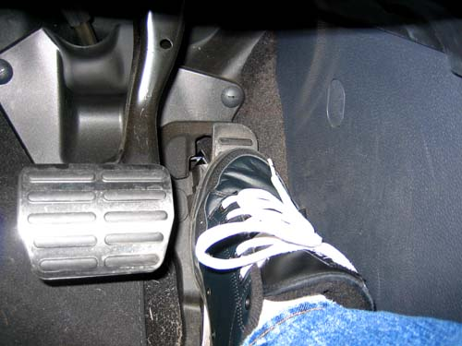
How can schools design for the future?
Golden rule: Use open standards.
Keep your choices open
Notes:
Gas on the right, break on the left…. It works, this is the standard. Try driving a Model-T some day and you will see how difficult non-standard is.
If you choose a NON-standard choice you are locking yourself into that decision and away from some other options latter.

Slide 21

Cloud-Managed Networking Security
Always on security
WPA2 encryption
Wireless IDS
Detects rogues and denial of service attacks
Embedded firewall
Provides role or SSID based access and is application aware
Traffic encryption
WPA2 between client & AP Encryption between AP & cloud

Slide 22
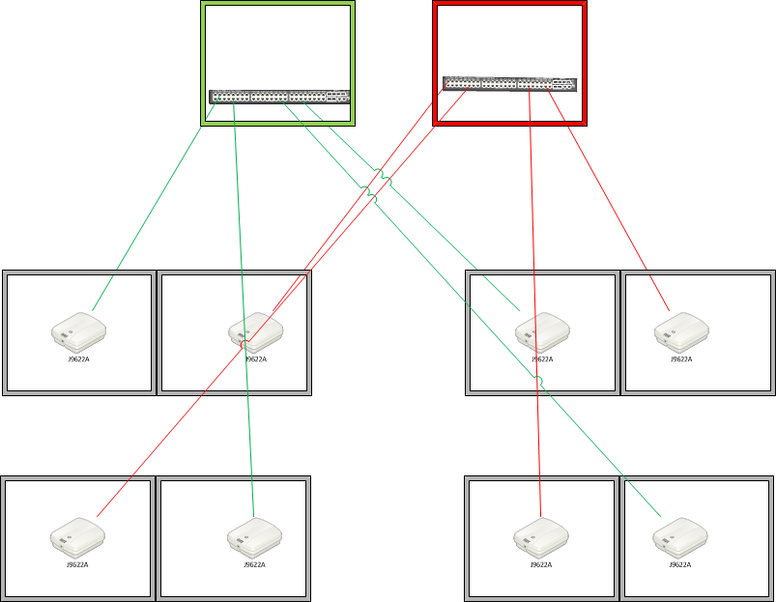




Additions needed for Common Core
Notes:
High availability – If AP’s are installed to diverse wiring closets then one failure does not take down all rooms in an area.
Bandwidth Upgrade and redundancy -
Increased Security – BYOD means a diversity of devices to secure. A house alarm and a car alarm are installed very differently.
Power availability – can you power all laptops with the power in the rooms?
Monitoring ability – historically quantify bandwidth to students was adequate

Slide 23


HP’s Vision for the future of networking in education
A new Networking paradigm for the 21st Century
Focus less on managing infrastructure…
…and more on supporting meaningful student outcomes
Notes:
HP’s Virtual Application Networks are our vision for Software Defined Networks.
Virtual Application Networks enable businesses to spend less time managing infrastructure and more on connecting users to applications.

Slide 24
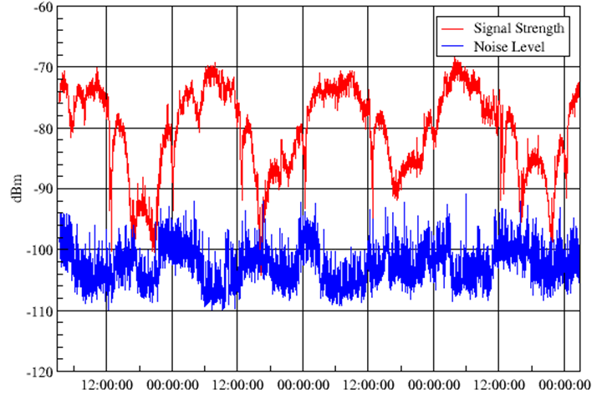


Wireless fundamentals
Signal to Noise Ratio – SNR
One AP’s signal is another's noise
More power = more noise

Slide 25
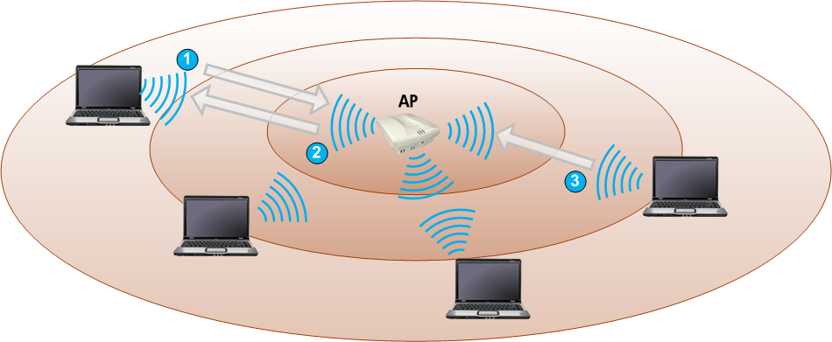
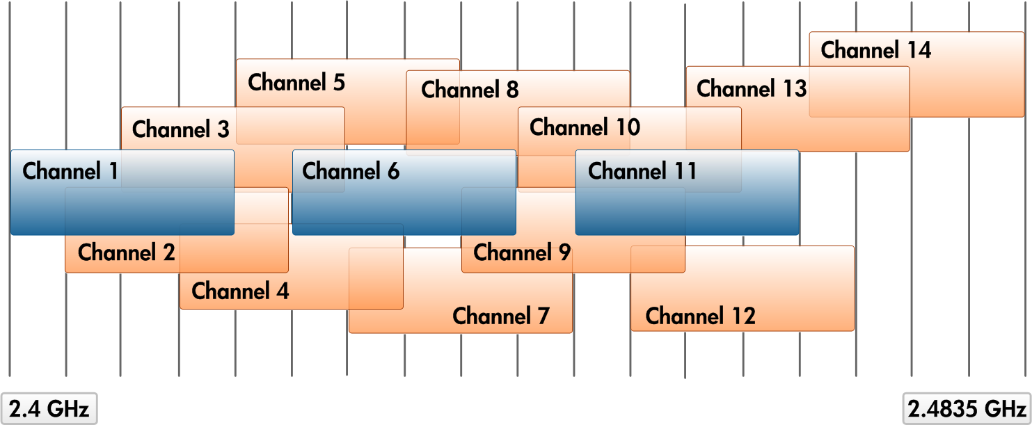
Wireless cell
Fixed number of devices per Access Point Radio
Channels in the 2.4 GHz band
These channels must not overlap.
Notes:
Wireless cell
The coverage area in which the AP and stations can communicate with each other is called a wireless cell. To communicate, a station must be able to detect the AP‘s signal, and the AP must be able to detect the station‘s signal. Therefore, an AP‘s exact coverage area might be different for each station, depending on each one‘s capabilities.
All the devices within a given cell share the same medium—the air through which the radio signals travel—but only one signal can be transmitted at a time on the same channel, or collisions and data loss occur. When only one user is in a cell, that user has on-demand access to the medium. When many users are in a cell, they must compete for airtime, which means decreased network performance.
To prevent loss of data due to simultaneous transmissions, the 802.11 standard dictates that all wireless communications be half-duplex—only one end of the link may transmit or receive at a time. Further, the stations use carrier sense multiple access with collision avoidance (CSMA/CA). Before a station can transmit data, it must first ―”listen” to determine if another station is sending data. If no other station is transmitting, the station can begin sending its data. If another station is already transmitting data, however, the original station must wait the amount of time specified in the slot time parameter before trying to send a frame. (Slot time is a parameter you can configure on the AP). Although these guidelines allow devices to share the same medium, they limit the throughput.
The 802.11 standard also requires certain non-negotiable ―overhead‖—data required by the wireless system but which is not form part of the relevant frame payload. For example, a device must send an ACK frame each time it receives a frame intact. In addition, the 802.11 header is longer than an Ethernet header; each header may include destination, origin, and transmitter addresses, initialization vectors (IVs) for encryption keys, and other Layer 1 and Layer 2 data.

Slide 26



Coverage and capacity
Coverage—providing wireless signal where it is required
Capacity—ensuring the wireless cell can support the required throughput of clients
Notes:
Coverage and capacity
When implementing a wireless network, you must consider both coverage and capacity:
Coverage—Coverage refers to providing the wireless signal where it is needed. Likewise, you must identify areas where the company does not want the wireless signal and try to avoid allowing the signal to leak into those areas.
Capacity—Capacity refers to the cell‘s ability to carry a data load—its throughput. In other words, how much data can the cell reliably support at its devices‘ configured powers and speeds?
As long as device configurations do not change, cell capacity does not change—overall throughput remains the same in the more densely occupied cell as in the less crowded one. However, the per-user throughput decreases as more stations join the cell. As the capacity ceiling is approached, users will begin to notice decreased speed and reliability.
User density is perhaps the most obvious and easily controlled element that affects capacity. If more users occupy a cell, more bit streams are in the air or in buffers competing for limited resources.
You will now consider the factors that affect both coverage and capacity.

Slide 27

Omnidirectional vs Directional Antennae
Think of an antenna as a light bulb
Omni antenna is similar to the light given by a single bulb without any fixture (reflector)
When the light bulb is placed into a housing that provides a reflector (like a flashlight), light is emitted in a direction that is controlled by the reflector and focused at some point / direction

Slide 28
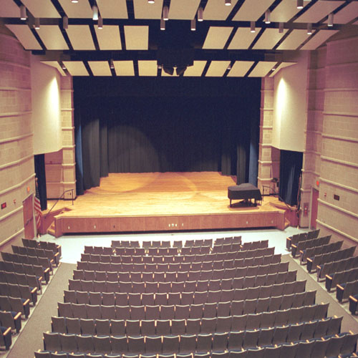

Physical considerations
Where do the systems get power from?
Cable management
Power Circuit Overload
Visual Barriers
External keyboard requirement
Written requirement for math portion
Headphone requirement for language portion

Slide 29
Wireless Considerations
Wireless is a shared medium, speeds will be slowed down by older devices.
Wireless signals are severely degraded or blocked when passing through liquid.
Humans are predominantly made of liquid.
A key consideration is linear (line of sight) vs. cell (pockets) coverage for channel mapping

Slide 30

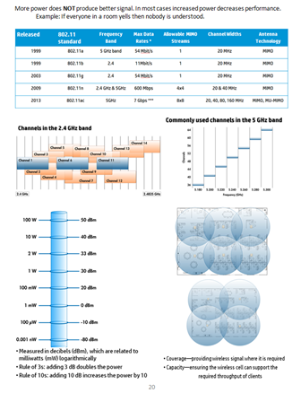
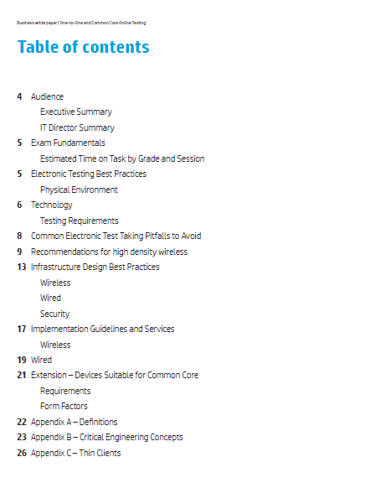
A document that can be easily referenced

Slide 31
Bandwidth calculations
Minimum bandwidth for testing
50kbps per student
X 100 students
----------------
5,000kbps / 1024 (kbps to Mbps)
= 4.88Mbps / 8 (bits to bytes)
=0.62 MB/sec
80% utilization max
Need ~0.73M/sec per 100 students
-> 7.3M/sec for 1,000 students
THIS IS ONLY THE EXAM BANDWIDTH NEED!
Options:
Dual ISP’s active
One ISP active, the other as backup
Caching server at school location
Questions you need to answer:
Will we use ‘live’ Internet testing or will we cache the exam on a local server?
What is the emergency plan if the Internet is DOWN on the day of the exam?
Notes:
Email, backups and other daily services take up bandwidth. You need to determine what your average network and Internet utilization is and then ADD the internal capacity and Internet speed needed to perform this exam.f

Slide 32
声明：
所有的版权属于原有公司，文件均来自公开渠道
此文件仅供学习使用，任何人不得进行以此为商业目的的行为
如有疑问，请立即删除
学习世界五百强和咨询公司PPT课程请访问如下网站搜索：“司马懿”
百度传课：司马懿PPT学校
网易学堂：司马懿PPT学校
知乎： 司马懿PPT学校
访问地址
https://www.chuanke.com
访问地址
https://study.163.com
访问地址
https://www.zhiu.com

